Slide 1
Think champ private limited
Free Excel Training
Basic to advance Training

Slide 2
Topics to be covered
Excel Introduction
Why Excel
Overview of Excel
Basic formulas
Range

Slide 3
Excel Introduction
What is Microsoft Excel?
Microsoft Excel is a powerful spreadsheet program developed by Microsoft.
It is part of the Microsoft Office suite, which includes other popular applications like Word and PowerPoint.
Excel is pronounced "Eks - sel“
The first version was released in 1985 and has gone through several changes over the years.

Slide 4
Usage of MS Excel
As MS Excel is widely used for various purposes, some of the MS Excel usage is defined as follows:
Data Entry
Time Management
Accounting
Financial analysis
Charting and Graphing
Financial Modeling
Programming
Task Management and Data Management
Customer Relationship Management(CRM)
Mathematical Calculations
Human Resource Management

Slide 5
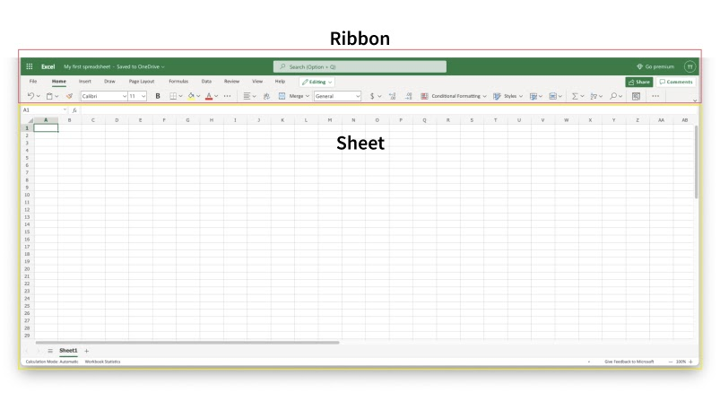
Overview of excel
Excel's structure is made of two pieces, the Ribbon and the Sheet.
The Ribbon is marked with a red rectangle and the Sheet is marked with a yellow rectangle:

Slide 6
Ribbon
The Ribbon:
The Ribbon is like a control center in Excel where you find buttons for doing things.
It might look crowded, but don't worry—it gets easier with practice.
It helps you do actions, like making tables, changing font size, or coloring cells.
Parts of the Ribbon:
App Launcher: It's the icon with nine dots. It helps you switch between different Office 365 apps like Word and PowerPoint.
Tabs: Think of tabs like menus. Each tab has different groups of actions.
Groups: Groups are like sections in each tab. They group similar actions together.
Commands: Commands are the actual buttons you click to do things.

Slide 7
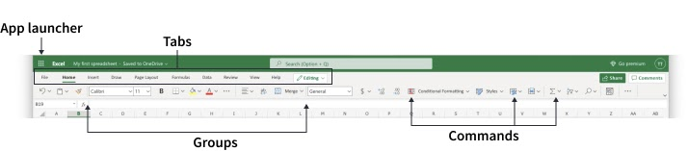
Ribbon Parts

Slide 8
Sheet
The Sheet is like a big grid in Excel made up of rows and columns.
Imagine it's like the pages of a math exercise book with lots of little rectangle boxes.
Cells:
Each little rectangle box in the grid is called a cell.
You can think of cells like the spaces where you write your answers in a math book.
Values:
You can type things into these cells, and we call these things "values."
Values can be numbers (like 5 or 10) or letters (like A or B).

Slide 9
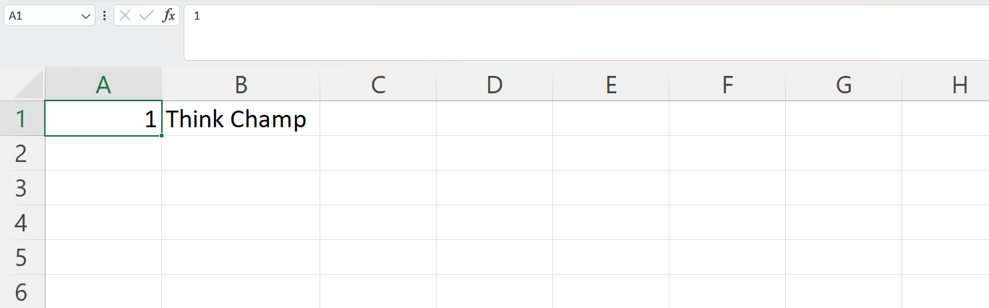
sheet

Slide 10
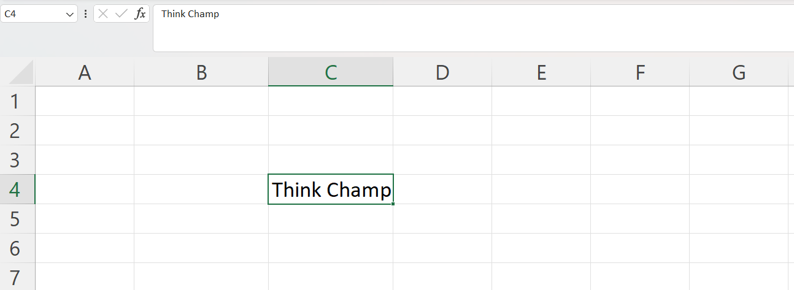
Sheet
Each cell has its unique reference, which is its coordinates, this is where the columns and rows intersect.

Slide 11
Multiple Sheets in excel
In Excel, you don't just have one sheet; you can have many sheets in one file. This is handy for organizing different kinds of information.
How to Add New Sheets:
Click on the plus sign at the bottom left corner, or press Shift + F11 to make new sheets.
Renaming Sheets:
Right-click on the sheet's tab (the small tab at the bottom) and choose "Rename" to give it a more helpful name.
Challenge:
Let's make two new sheets using the plus sign or Shift + F11.
Right-click on each sheet's tab, select "Rename," and give them useful names.

Slide 12
Formulas in Excel:
In Excel, formulas are used for mathematical calculations. They always start with the equal sign (=) followed by the calculation you want to perform.
Creating Formulas, Step by Step:
Select a Cell: Click on the cell where you want the result of your formula to appear.
Type the Equal Sign (=): Start your formula by typing the equal sign (=) in the selected cell.
Select a Cell or Type a Value: Choose a cell that has a value or type a value directly after the equal sign.
Enter an Arithmetic Operator: Add (+), subtract (-), multiply (*), or divide (/) the selected cell or typed value.
Select Another Cell or Type Value: Choose another cell or type another value to complete your calculation.
Press Enter: Hit the Enter key to execute the formula.

Slide 13
Thank you

